Slide 3
CREATIVITY WEEK

Slide 4
Sankalp & UFHE ( United forum for health and environment) TOGETHER CELEBRATE “Unleash Your Creativity month” in June 2016 SPEECH COMPETITION @ TELCO CENTRE

Slide 5
HIGHLIGHTS
Sankalp & UFHE celebrated Environment Week and conducted quiz and drawing competition for kids at Telco Centre.
Major Events to be conducted during the week will be
Drawing Competition
Wax/Clay Model Making
Speech Competition
Quiz
The event takes place regularly where we intend to figure out talented students form the lot and impart them with necessary skills through appropriate training

Slide 6
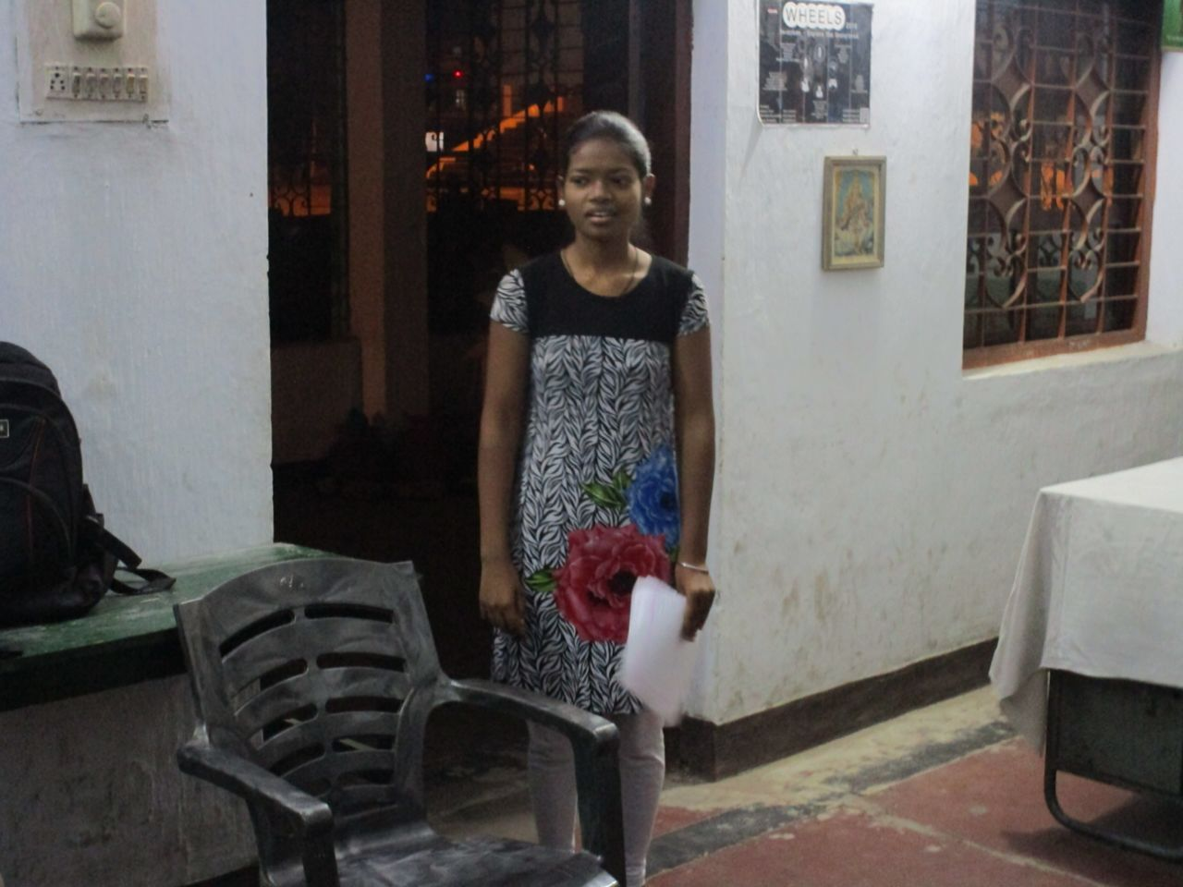

Slide 7
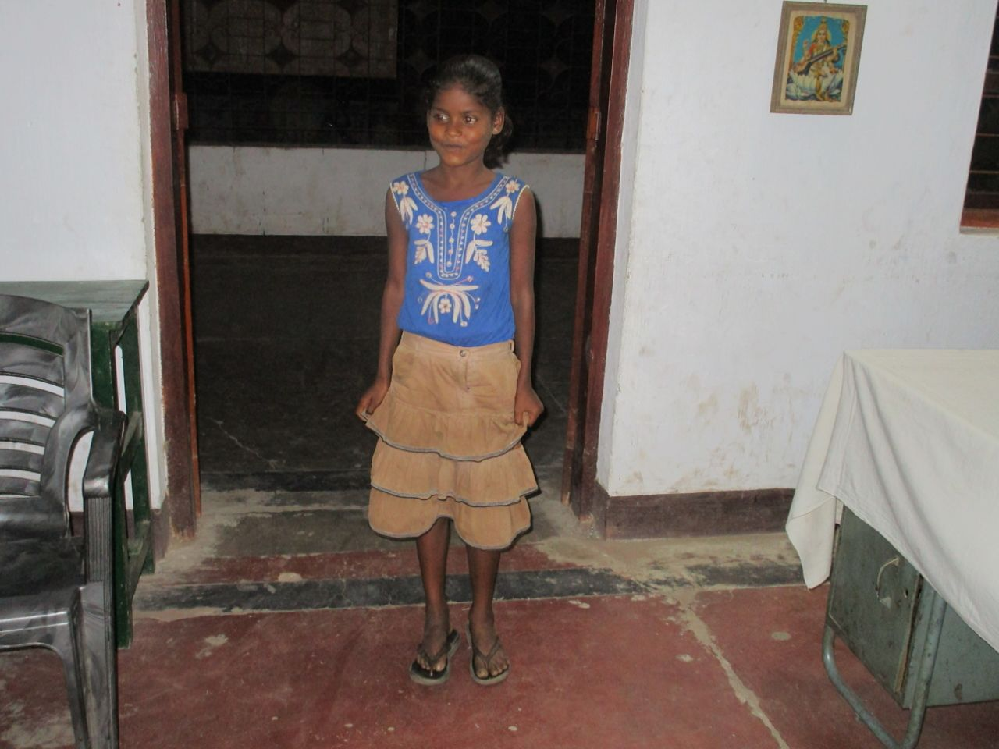

Slide 8
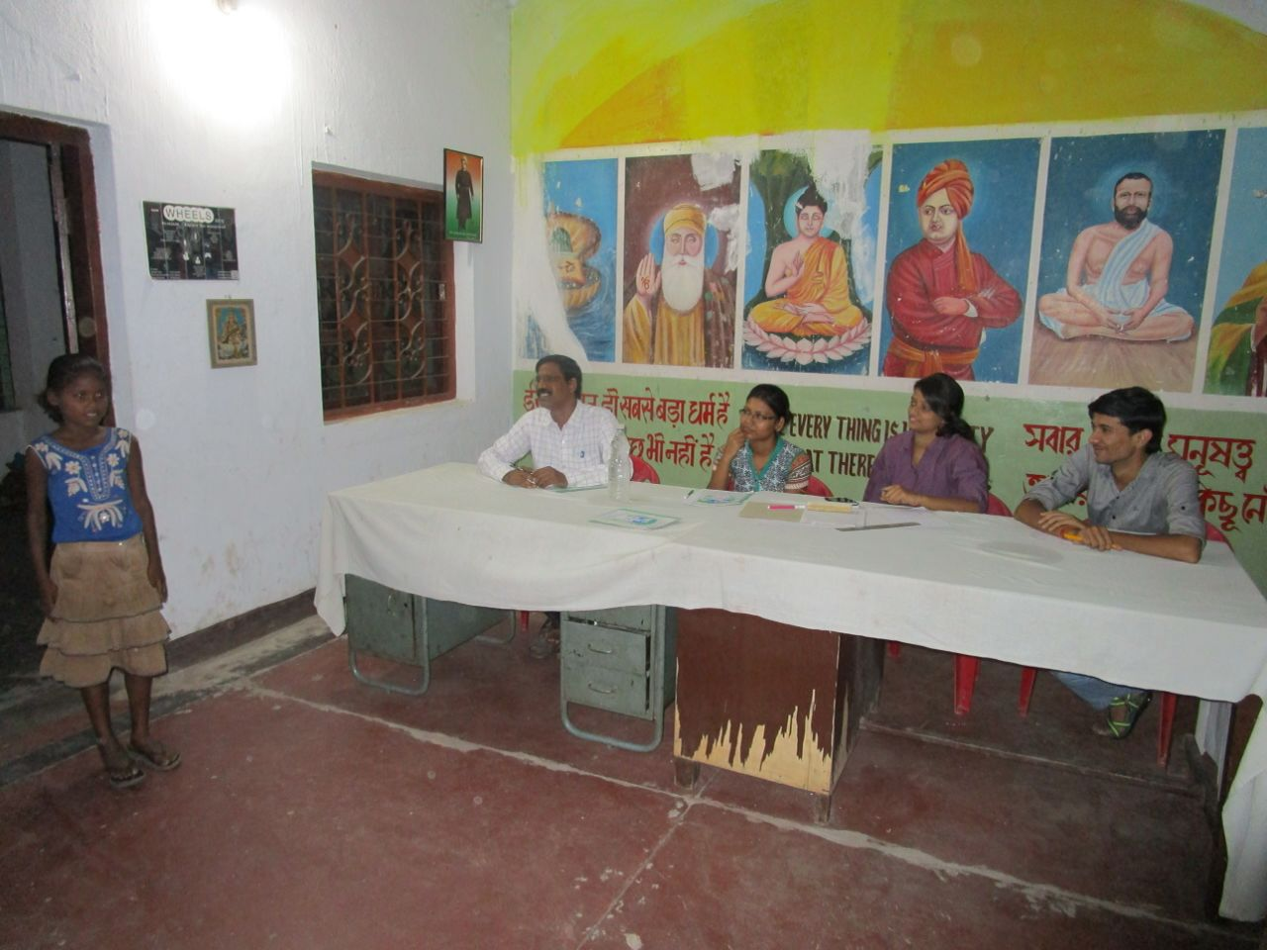

Slide 10
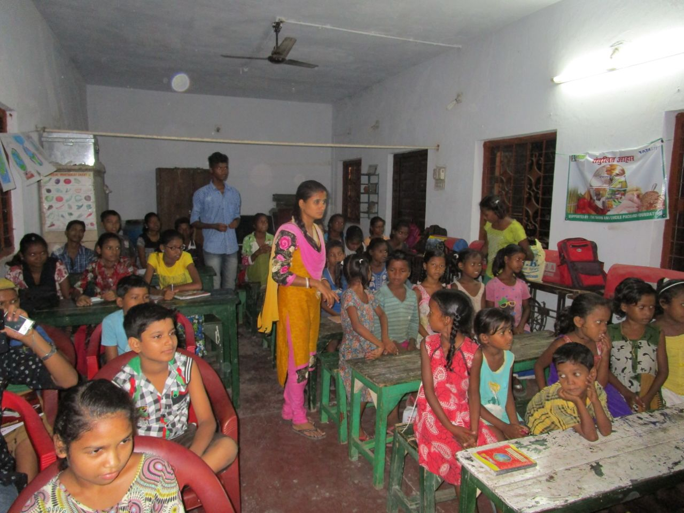

Slide 11
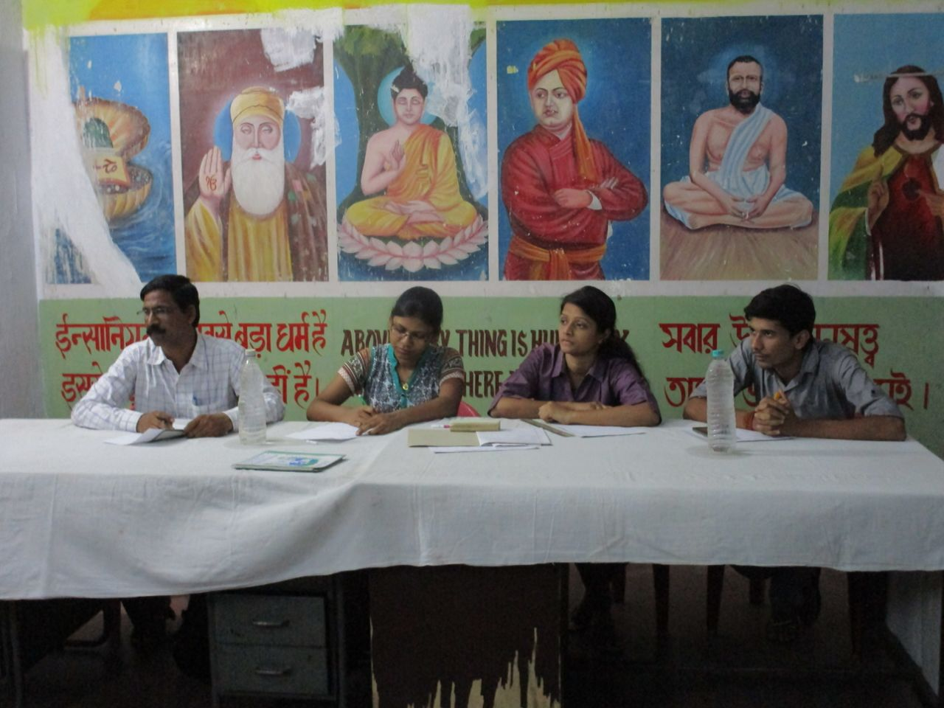

Slide 12
And this is all because we believe that.....

Slide 13
BE A PART OF THE JOURNEY
You can donate at any our centres by just making a call to Sankalp-A Pledge to Change volunteers.
All our centres run 6 days a week
You may donate books from
Class 1-8- Course Text Books (Any Board)
Story Books
Unused stationery
Any other items like bag, toys, uniforms etc.
Relevant Contact Nos. Are
Subodh Kumar Das-9798756336
Mayank Aggarwal -9031975746
Suresh Pareek -7209632032
Vikas Dixit -9472706225

Slide 14
ACCOUNT DETAILS FOR SUPPORT
Sankalp Account Details
You can transfer funds online into our account:-
“SANKALP” A/C No.-31114719936
CIF No: 85757412911
IFSC Code: SBIN0001882
MICR Code: 831002004
Branch code: (1882)
Branch: SBI- RIT JAMSHEDPUR
You may also visit our website and pay through online link available over it.
www.sankalpnitjamshedpur.org

Slide 15
“You have not lived today until you have done something for someone who can never repay you.”
Thank You
www.sankalpnitjamshedpur.org

